Slide 1



University Collaboration and Technology Promotion on Digital Twins Trend in Automotive Industry
CARLA CONTEST 2023

Slide 2



Agenda
Background & Purpose
Digital Twins
What are Digital Twins?
Benefit
Fundamental Technologies
CARLA
What is CARLA?
How does CARLA Work?
CARLA Components
Autonomous Driving
What is Autonomous Driving?
Autonomous Driving Example
Autonomous Driving Knowledge Overview
Autonomous Driving Sensors
Sensors for Contest
Demo
Appendix

Slide 3
Background & Purpose
Currently, the automotive industry is moving toward the mobility innovation of the future which can refer to “CASE” framework (Connected, Autonomous, Sharing, Electric). The Digital Twins technology is one of the keys technology for this innovation.
Thus, the automotive requirement is more complex as well as testing scenario. In order to fulfill these requirements, the system & software development method has to be evolved and “Digital Twins” is one the key technology for this evolution in automotive industry.
We aim to promote digital twins trend of automotive software development industry and encourage university student to build career in automotive software development industry in Thailand.

Slide 4
Digital Twins

Slide 5
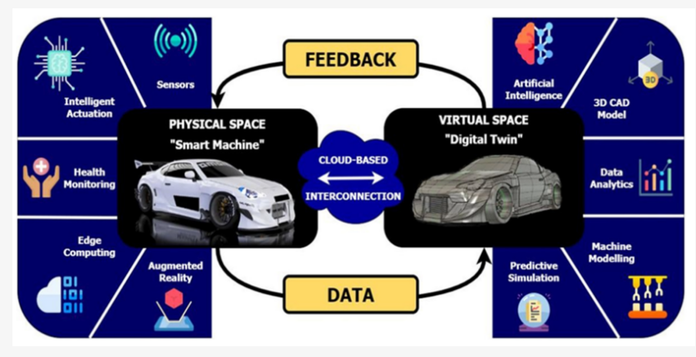
What are Digital Twins?
A digital twins are a digital representation of a physical object, process or system.
A digital twins are a computer program that uses real world data to create simulations, study performance issues and generate possible improvements which can then be applied back to the original physical object.
Reference: https://www.mdpi.com/2571-5577/5/4/65/htm

Slide 6
Benefit
No. | Type | Benefit
1 | Process | Digital twins can help to mirror and monitor production systems that are all synchronized to operate at peak efficiency, or will delays in one system affect others.
2 | Product | ADAS architecture is increased the ability to respond or detect threats by the knowledge obtained from sensor data stored on cloud and processed on digital twin.
3 | Service | Manufacturer maintains a digital record of the working condition of the car and also detects potential problems that are being fixed by simply downloading over-the-air (OTA) software updates.

Slide 7
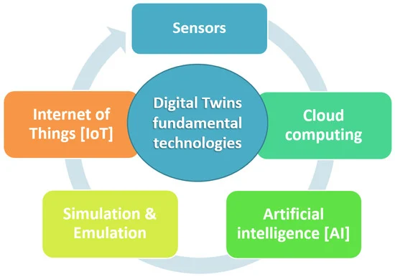

Fundamental Technologies
To detects a physical parameter of interest and converts it into electrical signal that can be measured
To provide the connection and access to the physical world and interlink with digital twin
To compute large data collected from sensors with high performance processor
To represent appearance and behaviors of the physical object in digital twin
To analyze data, generate behaviors model, and decision making in digital twin.
Reference: https://www.mdpi.com/2571-5577/5/4/65/htm

Slide 8
CARLA

Slide 9
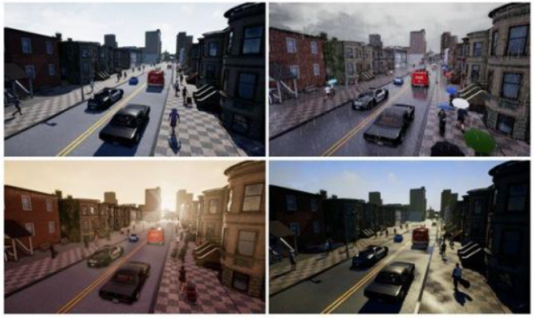
What is CARLA?
CARLA is an open-source simulator for autonomous driving research that provides open digital
assets, flexible specification of sensor suites and environmental conditions to support development,
training, and validation of autonomous driving systems.
This virtual simulator is also part of digital twins concept. We are going to conduct the workshop in
order to create own autonomous driving control software and run simulation on CARLA
environment.
.
Reference: https://carla.readthedocs.io/en/latest/start_introduction

Slide 10
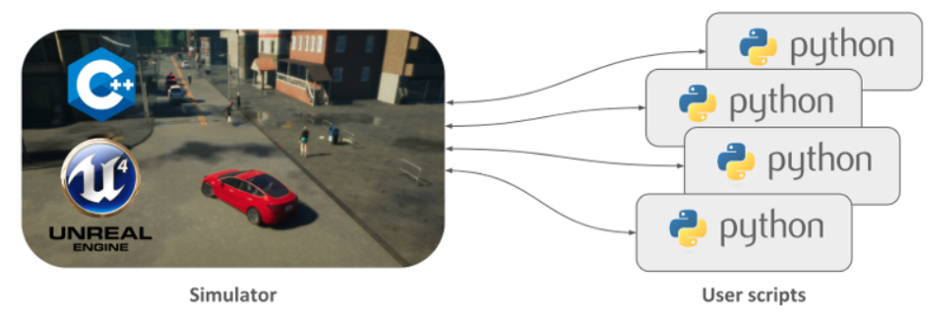
How does CARLA Work?
The CARLA simulator consists of a scalable client-server architecture.
The server is responsible for everything related with the simulation itself: sensor rendering, computation of physics, updates on the world-state and its actors and much more. As it aims for realistic results.
The client side consists of a sum of client modules controlling the logic of actors on scene and setting world conditions. This is achieved by leveraging the CARLA API (in Python or C++).
Reference: https://carla.readthedocs.io/en/latest/start_introduction/

Slide 11
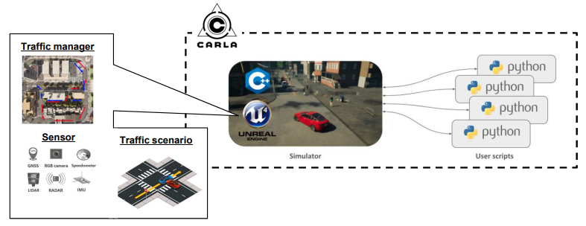
CARLA Components
Traffic Manager: A built-in system that takes control of the vehicles besides the one used for learning. It acts as a conductor provided by CARLA to recreate urban-like environments with realistic behaviors.
Sensors: Vehicles rely on them to dispense information of their surroundings. In CARLA they are a specific kind of actor attached the vehicle and the data they receive can be retrieved and stored to ease the process. Currently the project supports different types of these, from cameras to radars, lidar and many more.
Traffic Scenario: In order to ease the learning process for vehicles, CARLA provides a series of routes describing different situations to iterate on. These also set the basis for the CARLA challenge, open for everybody to test their solutions and make it to the leaderboard.
Reference: https://carla.readthedocs.io/en/latest/start_introduction/

Slide 12
Autonomous Driving

Slide 13
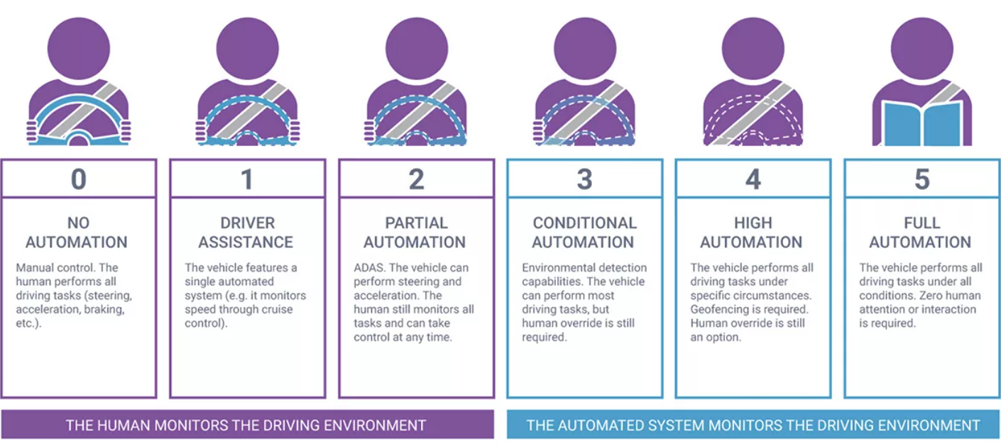
What is Autonomous Driving?
Autonomous driving is the system that supports driving with limited human intervention by using sensors, cameras, and artificial intelligence.
Level of Autonomous Driving
Reference: :https://https://www.synopsys.com/automotive/what-is-autonomous-car.html/

Slide 14
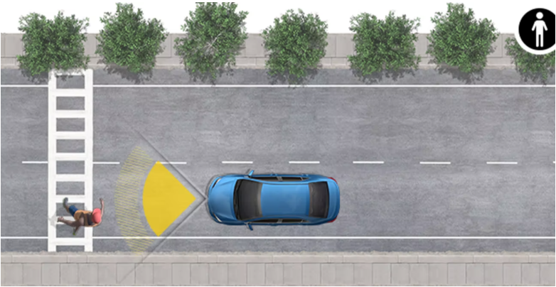
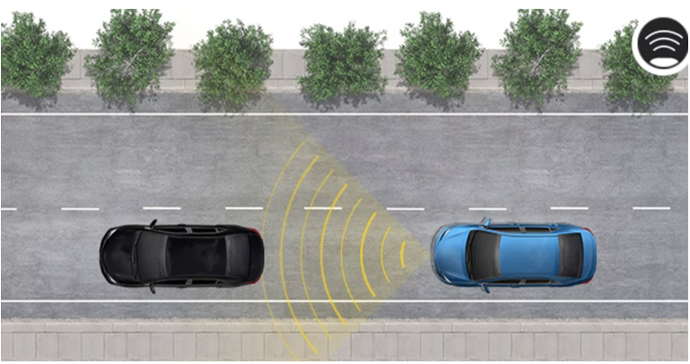
Autonomous Driving Example
Pre-Collision System with Pedestrian Detection
Pre-Collision System with Pedestrian Detection (PCS w/PD) is designed to help detect a vehicle or pedestrian and provide an audio/visual forward-collision warning under certain circumstances. If you don’t react, the system is designed to provide automatic emergency braking.
Dynamic Radar Cruise Control
Dynamic Radar Cruise Control (DRCC) is an adaptive cruise control system that uses vehicle-to-vehicle distance control to help maintain a preset distance from the vehicle ahead of you.
Reference: https://www.toyota.com/safety-sense/

Slide 15
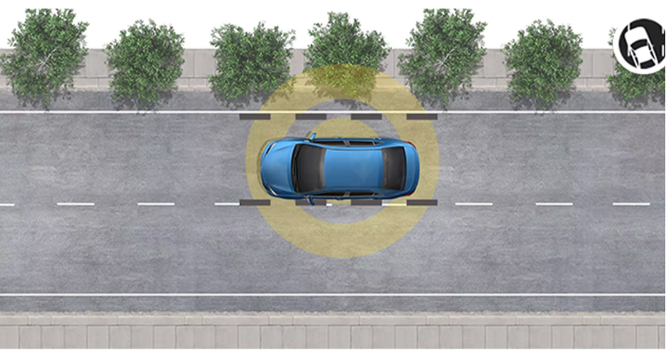
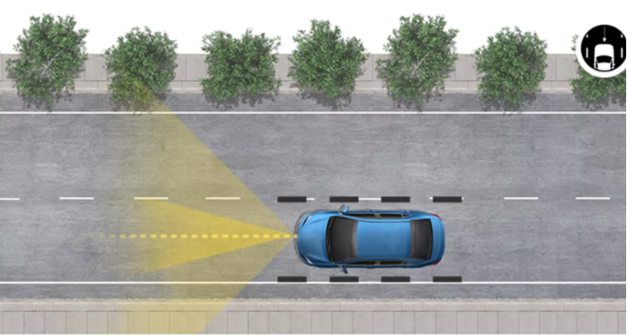
Autonomous Driving Example
Lane Departure Alert
When white/yellow lane markings are detected at speeds within the systems operating range, Lane Departure Alert (LDA) * is designed to issue an audio/visual lane departure warning if an inadvertent lane departure is detected.
Lane Tracing Assist
Lane Tracing Assist (LTA) uses the lines on the road and/or preceding vehicles to provide active driving assistance and help keep the vehicle centered and in its lane.
Reference: https://www.toyota.com/safety-sense/

Slide 16
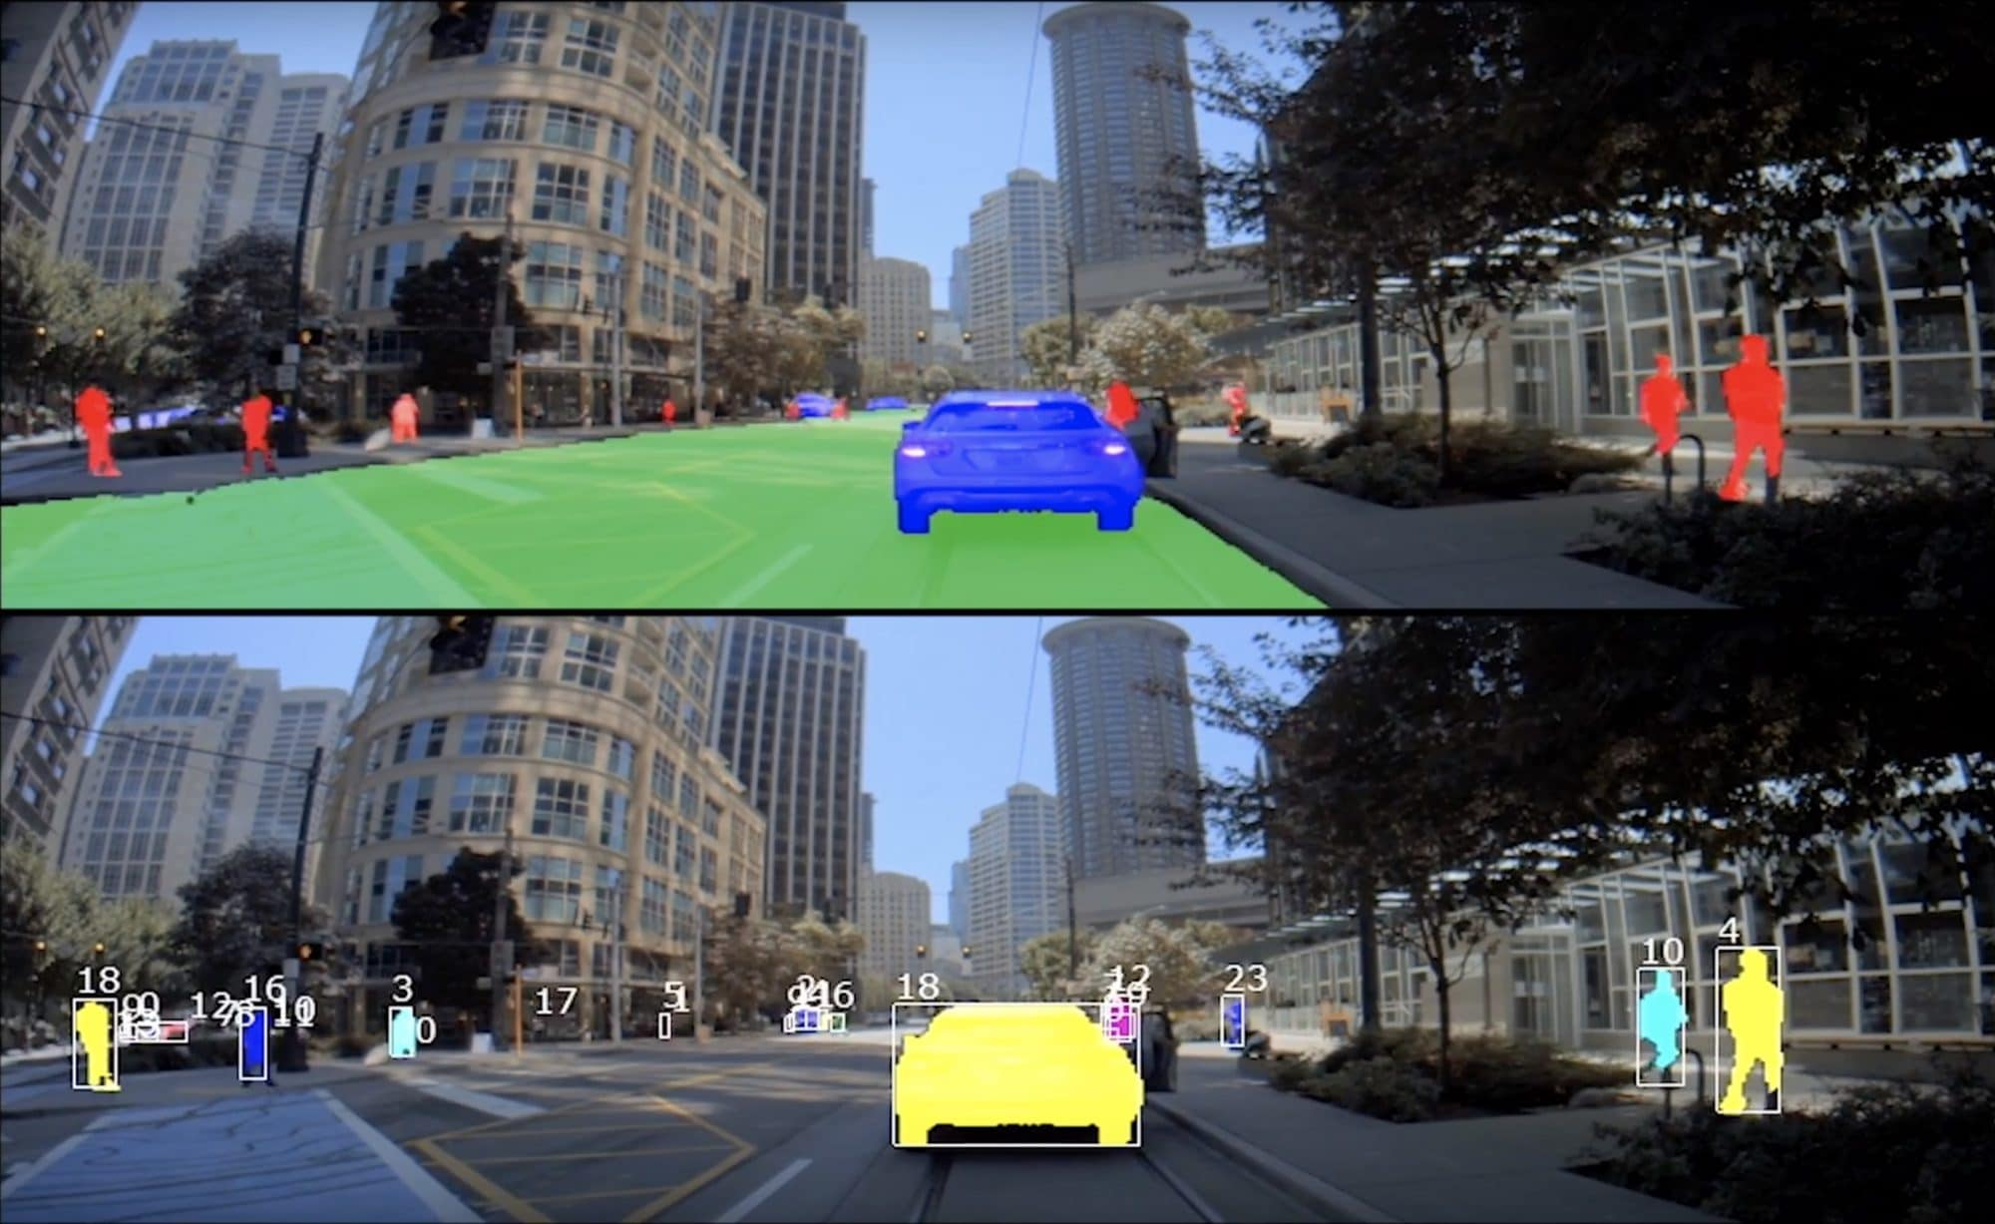
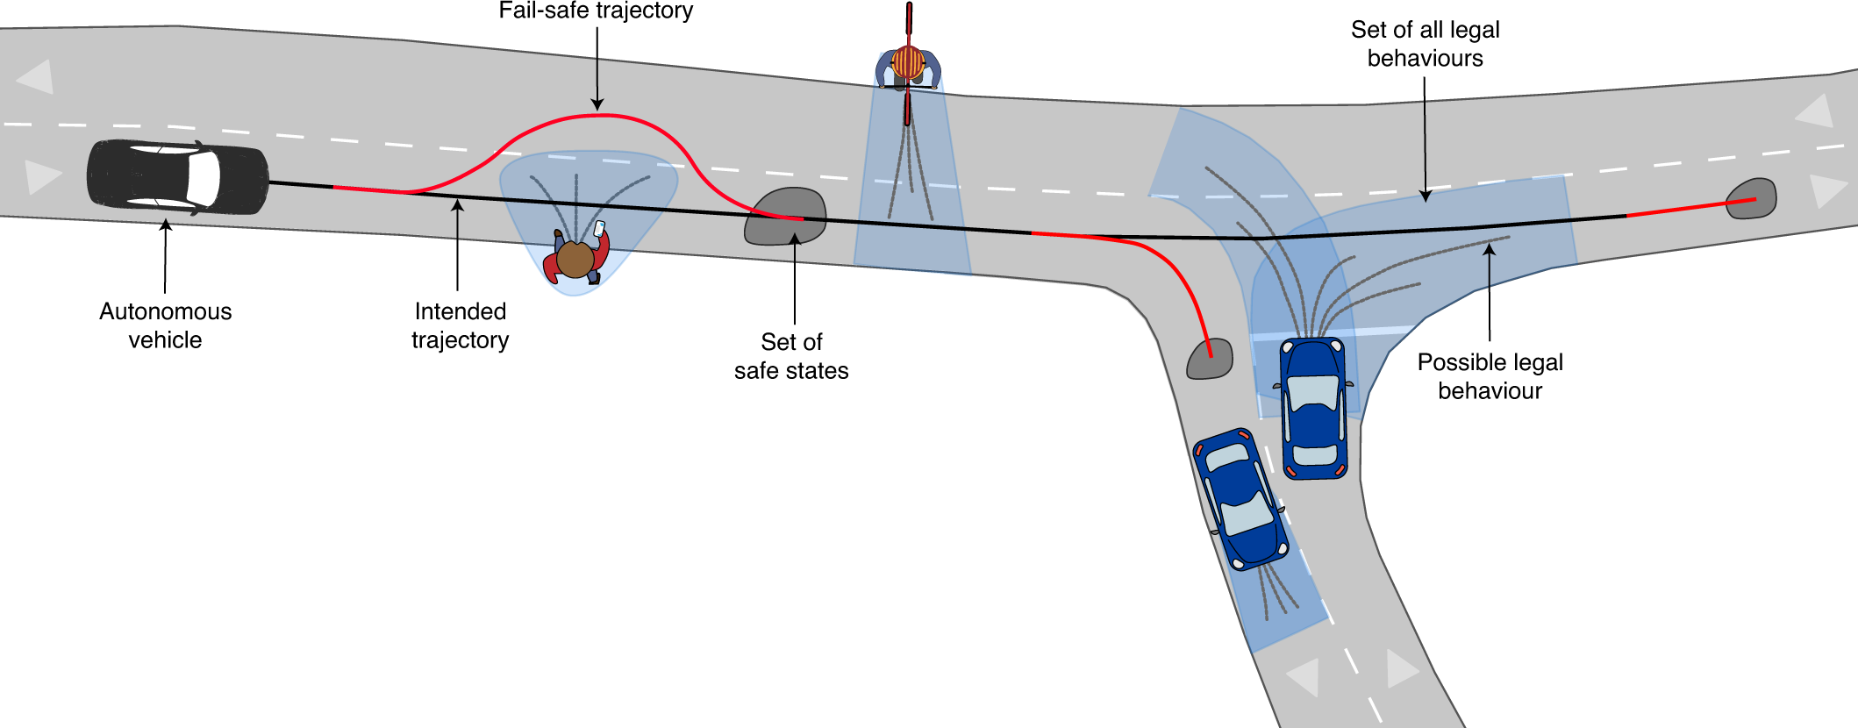
Autonomous Driving
Knowledge Overview
Concept
Perception
Path planning
A challenge of self-driving cars development is to detect road object for build the occupancy map.
Vehicle needs to consider the feasible path to avoid the obstacle or decided to stop for the pedestrian.

Slide 17
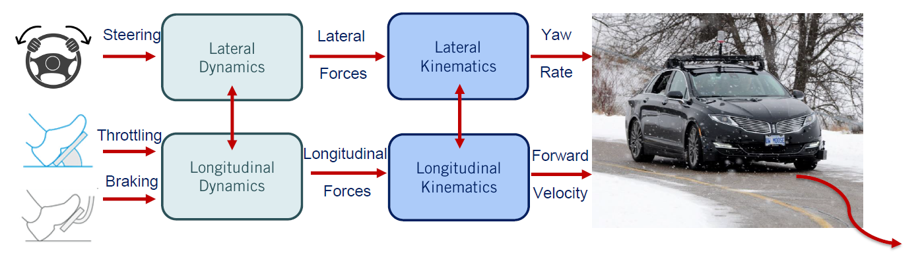
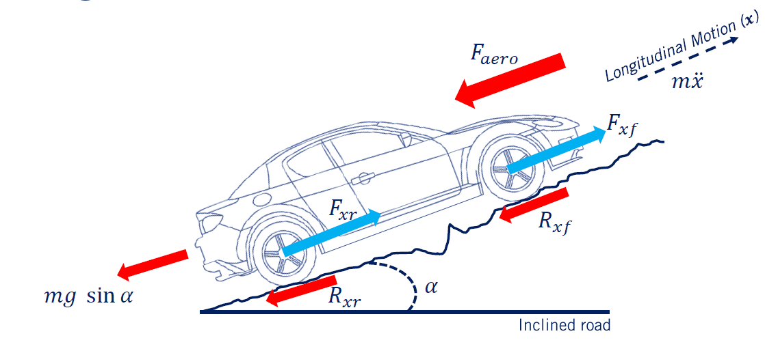
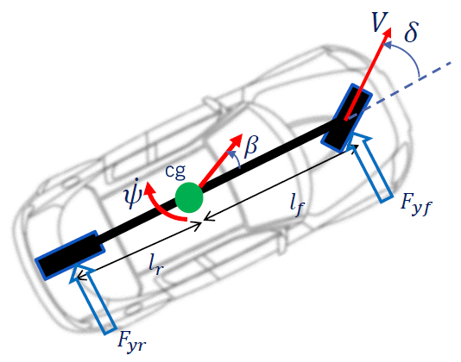
Autonomous Driving
Knowledge Overview
Vehicle Dynamics
Vehicle Actuation
Longitudinal Dynamics
Lateral Dynamics

Slide 18
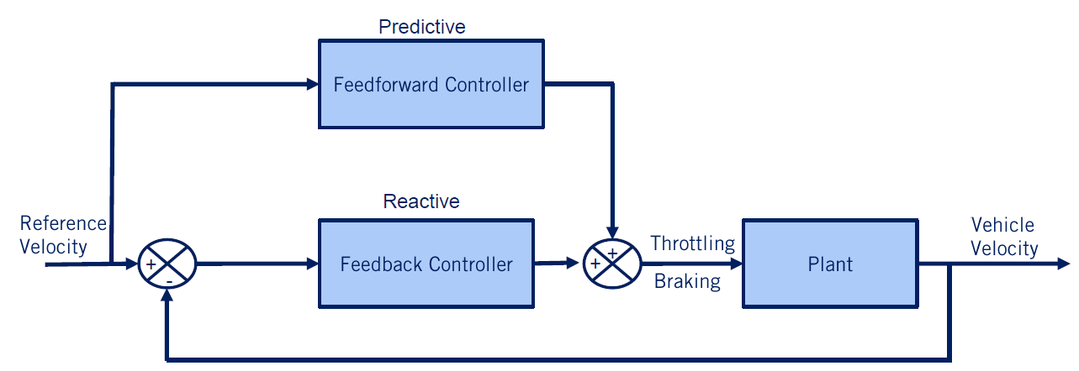
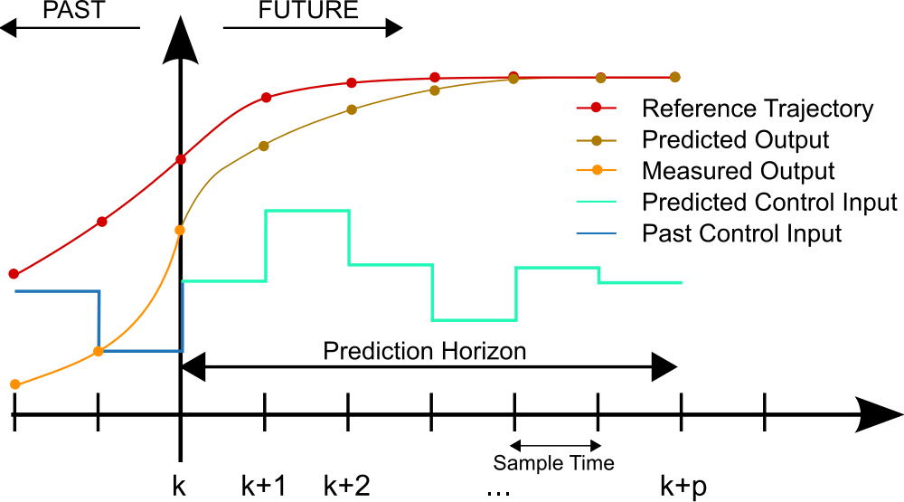
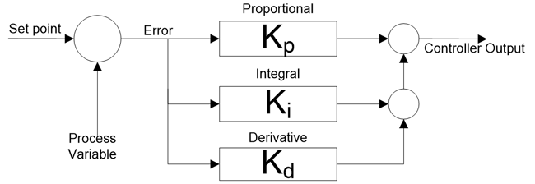
Autonomous Driving
Knowledge Overview
Basic Controller Design
Feedback – Closed Loop
Model Predictive Control
PID Control

Slide 19
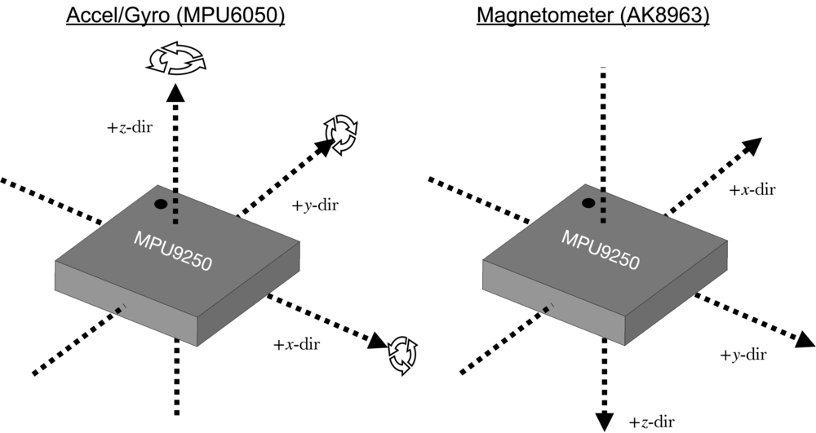
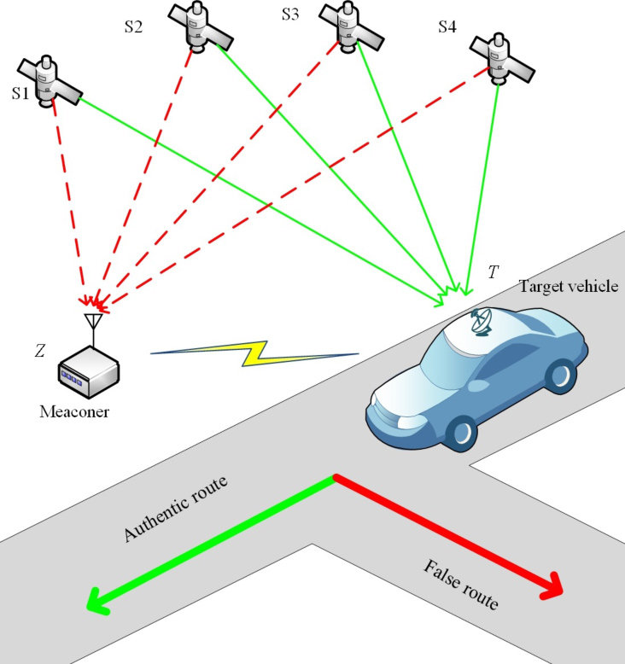
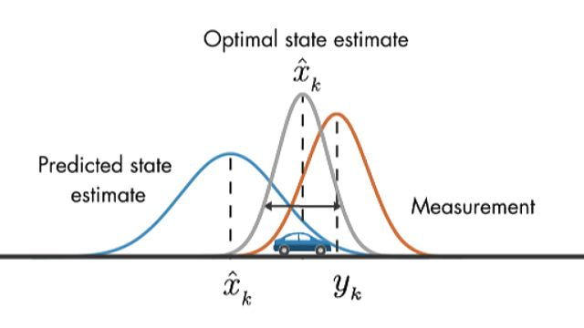
Autonomous Driving
Knowledge Overview
Ego Location Estimation
Sensor Fusion With Kalman Filter

Slide 20
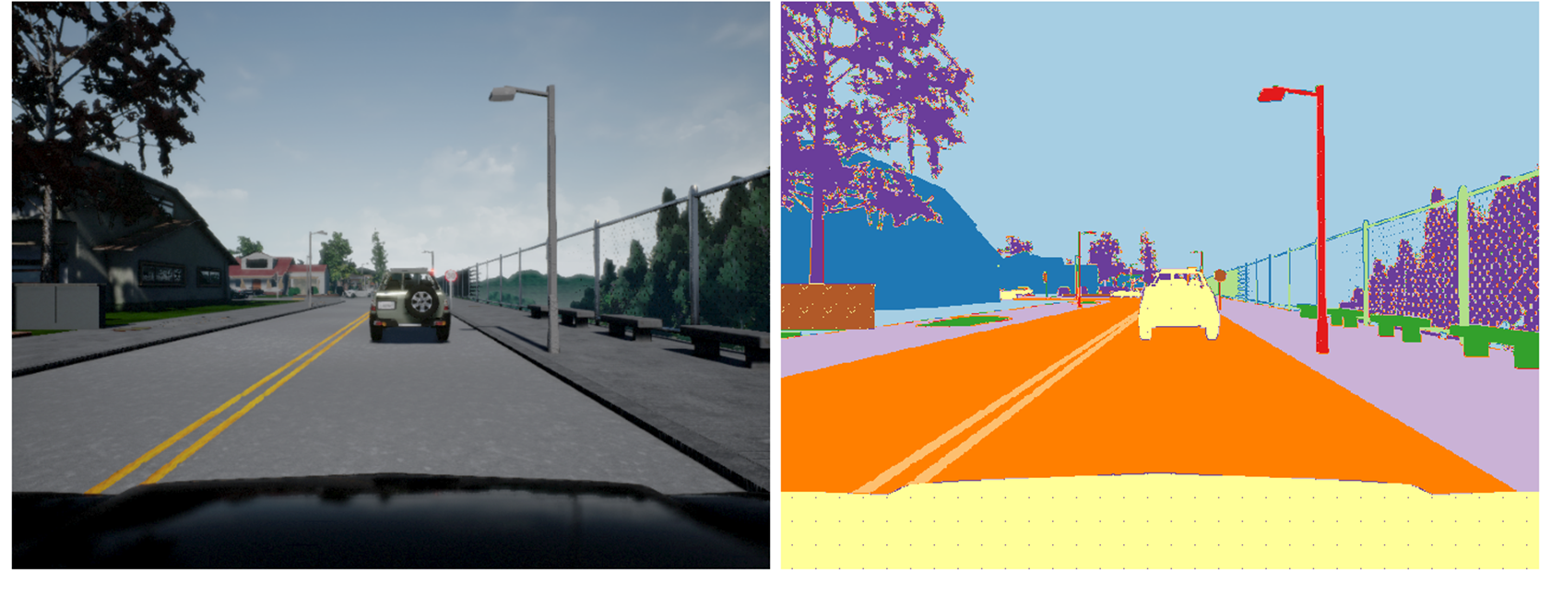
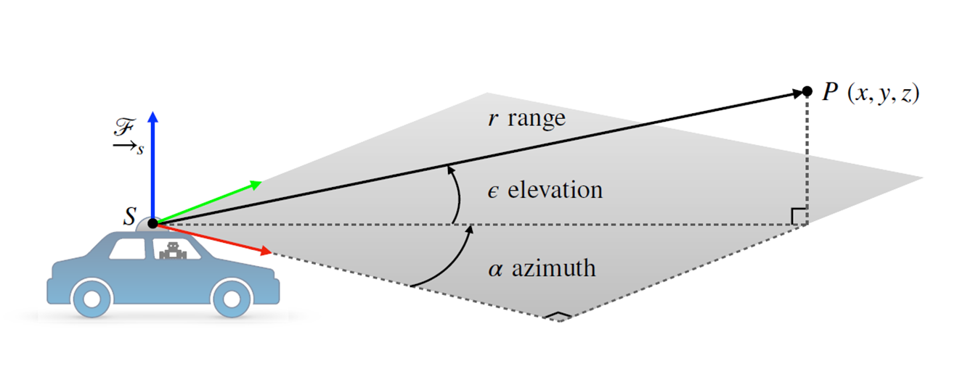
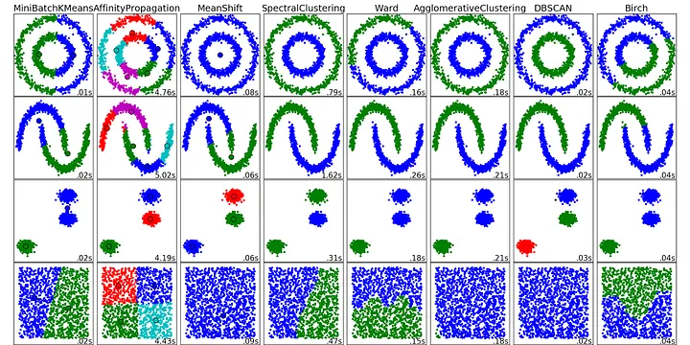
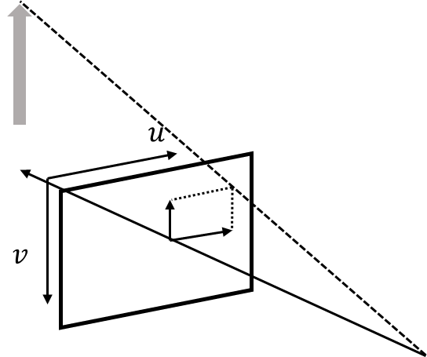
Autonomous Driving
Knowledge Overview
Sensor Data Processing
Clustering
Radar inverse sensor model
Density-Based Spatial Clustering of Applications with Noise (DBSCAN)
Sensor fusion

Slide 21
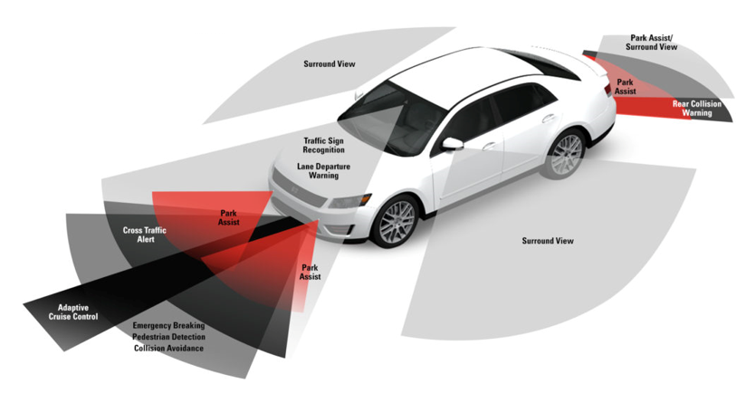
Autonomous Driving Sensors
Camera: provides realistic images that automatically detect objects, classify them.
Radar: to determine distance between object and sensor.
Lidar: more accuracy than radar and possible to build exact 3D models of objects surrounding vehicle.
GNSS (GPS): used for navigation and positioning measurements.

Slide 22
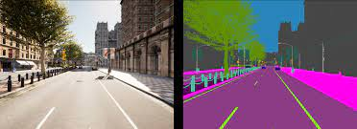
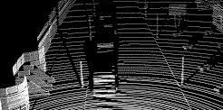
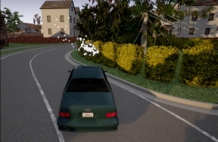
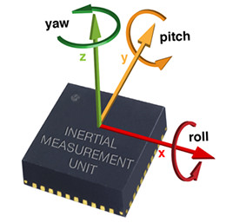
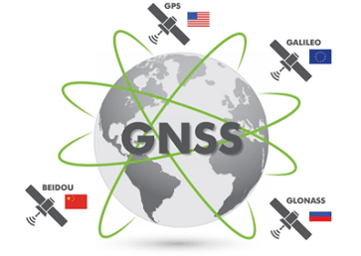
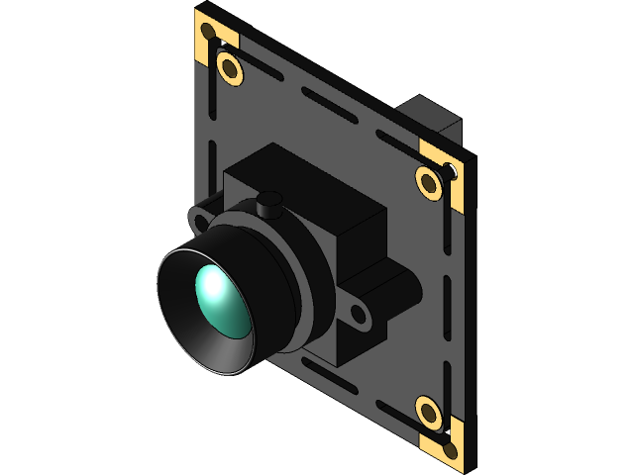
Sensors for Contest
Camera
LIDAR
RADAR
Inertial Measurement Unit
Sattellite location
Other sensors: carla.readthedocs.io/en/latest/ref_sensors

Slide 23
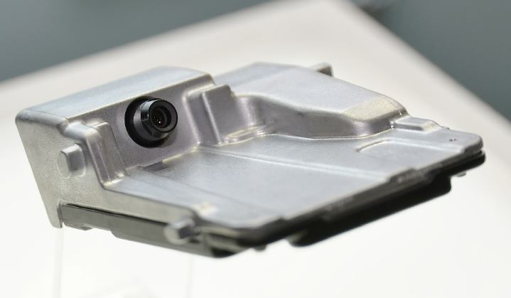
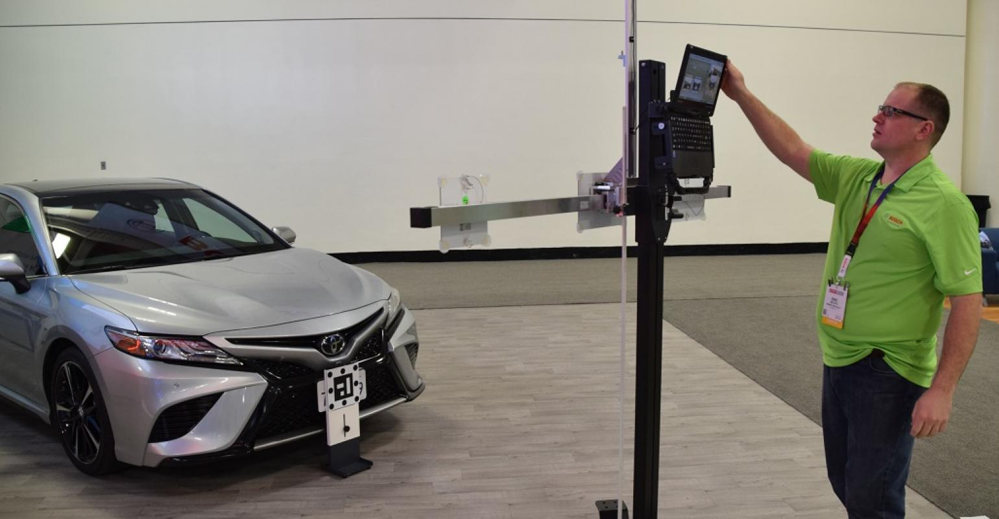
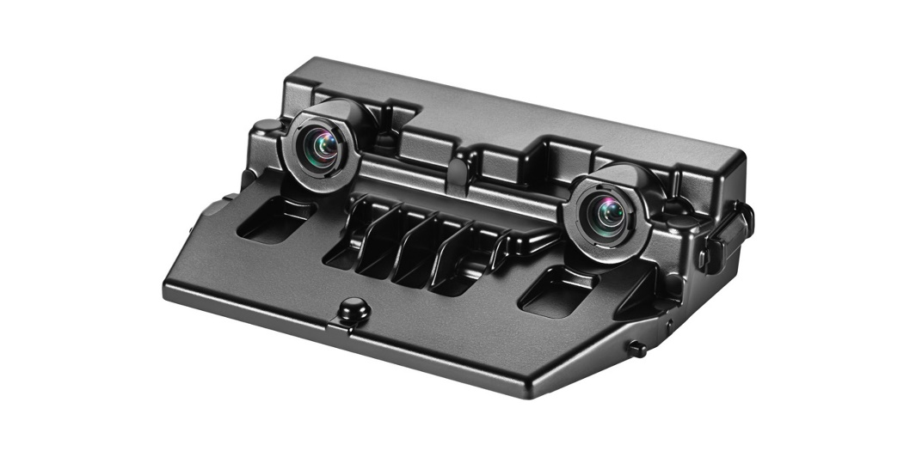
Sensors for Contest
Camera Module In TOYOTA’s car
Monocular Camera
Camera Calibration Process
Stereo Camera

Slide 24
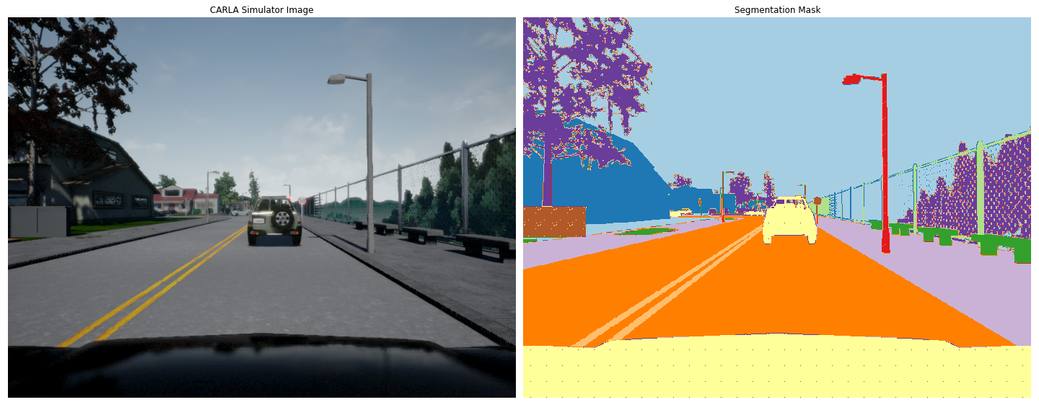
Sensors for Contest
CARLA Camera
RGB Camera
Semantic Ground Truth

Slide 25
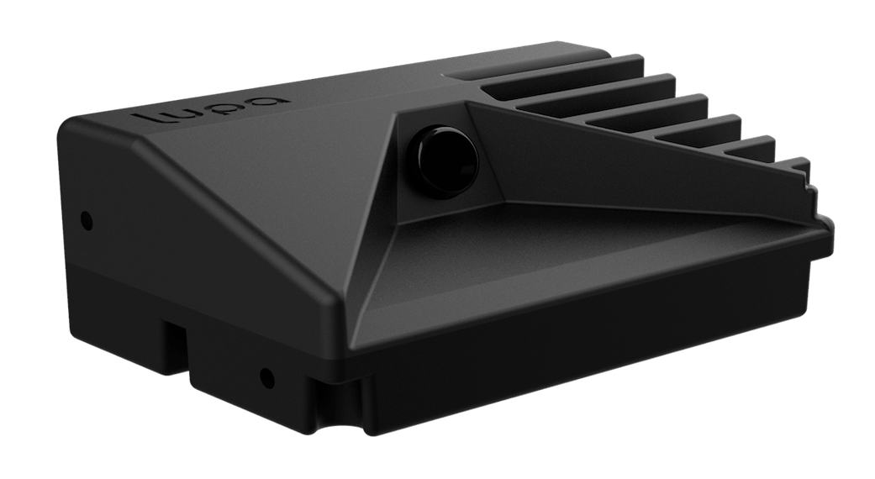
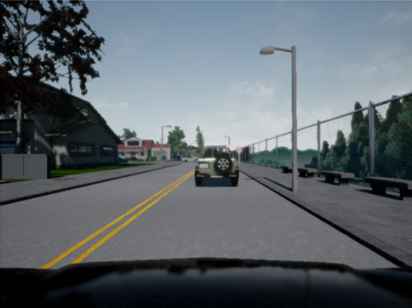
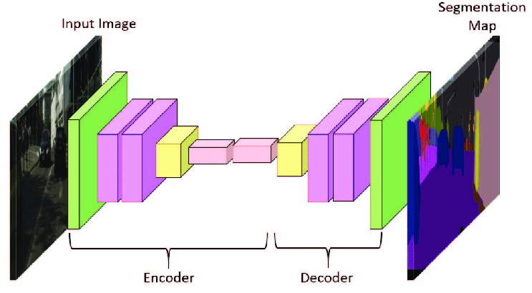
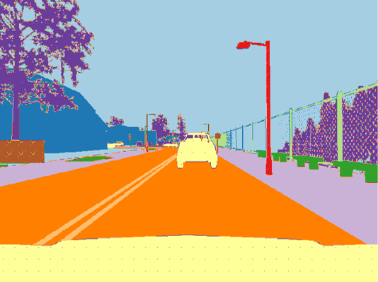



Sensors for Contest
CARLA Camera
RGB Image
Semantic Segmentation Labeled
Prediction
RGB Image
Improved computational speed
Semantic Segmentation Labeled
Reduced complexity / cost
Ground Truth

Slide 26
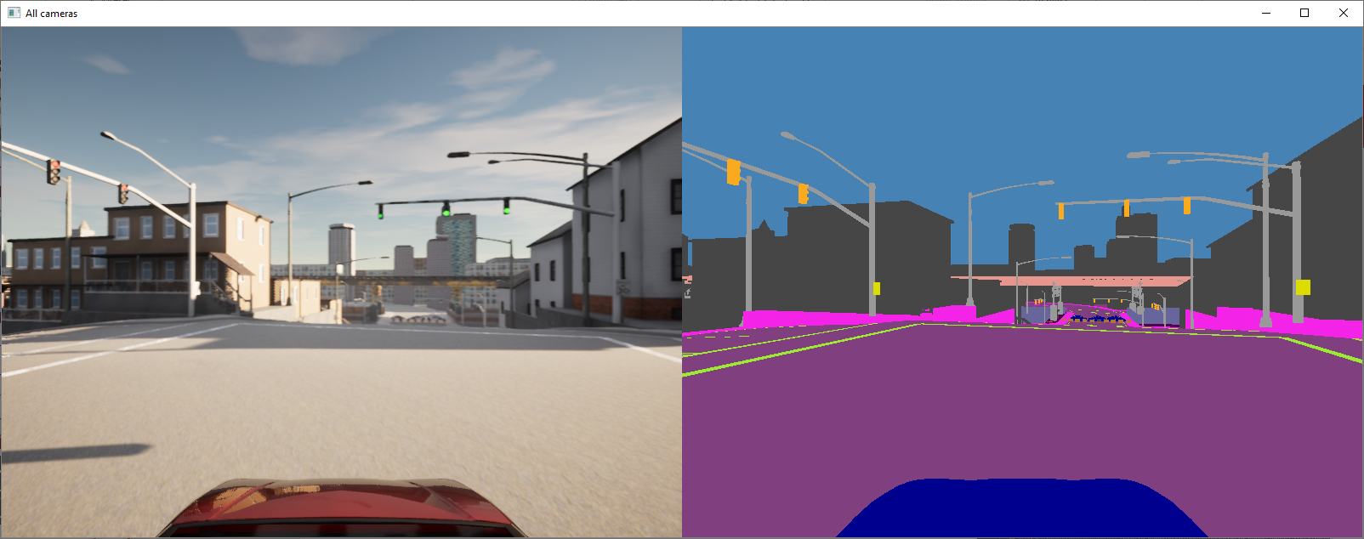
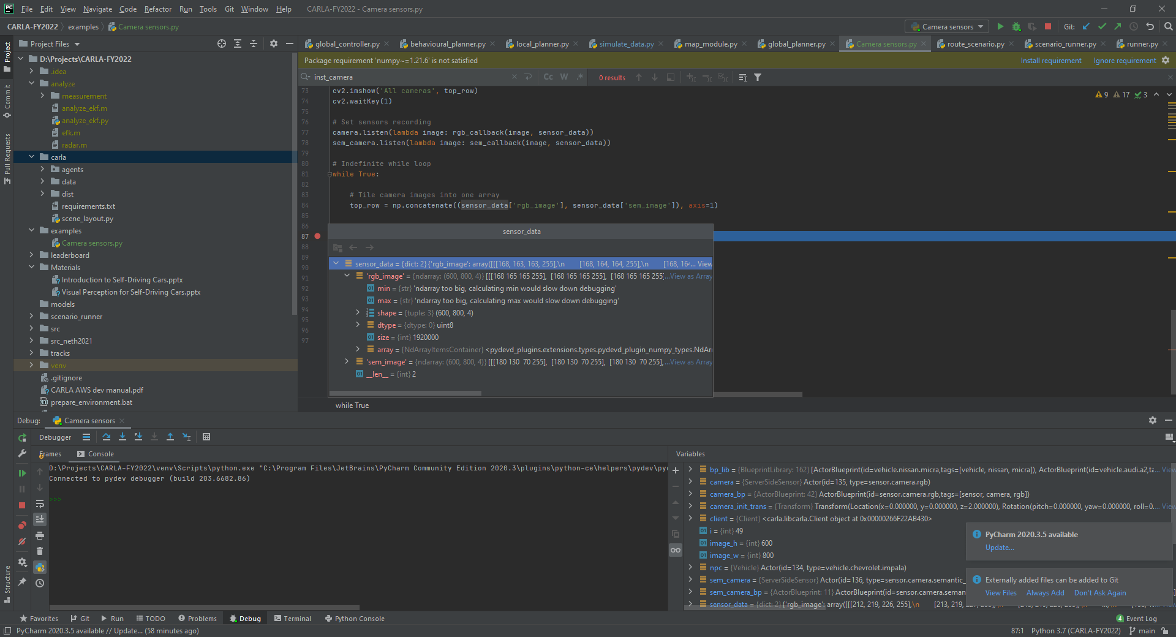
Sensors for Contest
CARLA Camera Coding Example
1. Initial sensor
# Set initial camera translation camera_init_trans = carla.Transform(carla.Location(z=2)) # Add one of each type of camera camera_bp = bp_lib.find('sensor.camera.rgb') camera = world.spawn_actor(camera_bp, camera_init_trans, attach_to=vehicle)
2. Define sensor callback function and data buffer
# Define respective callbacks def rgb_callback(image, data_dict): data_dict['rgb_image'] = np.reshape(np.copy(image.raw_data), (image.height, image.width, 4)) # Initialise parameters and data image_w = camera_bp.get_attribute("image_size_x").as_int() image_h = camera_bp.get_attribute("image_size_y").as_int() sensor_data = {'rgb_image': np.zeros((image_h, image_w, 4))}
3. Start recording sensor data
# Set sensors recording camera.listen(lambda image: rgb_callback(image, sensor_data))

Slide 27
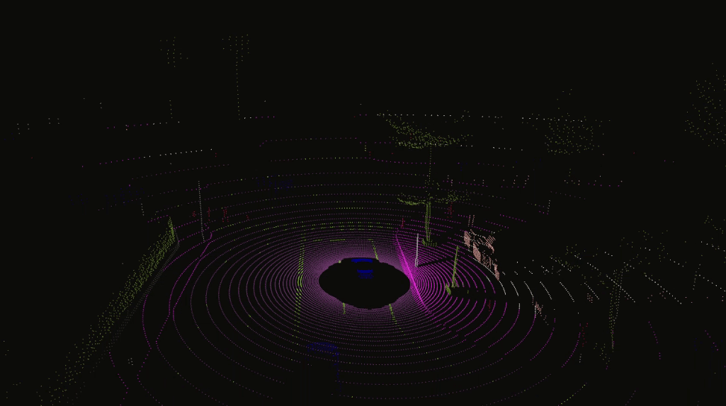
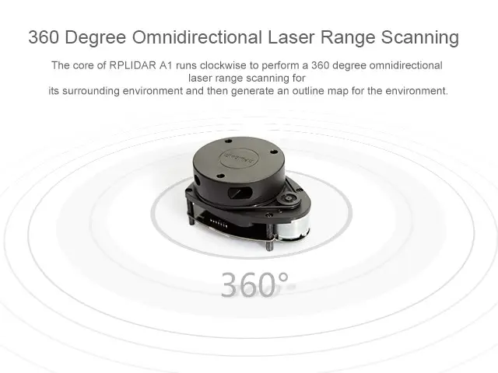
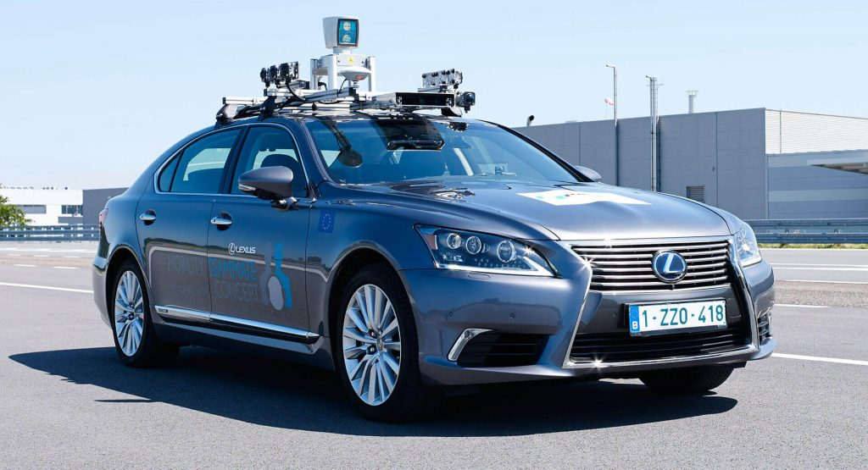
Sensors for Contest
Lidar (Light Detection and Ranging) is used the laser beam to measure the distance between sensor and an object.

Slide 28
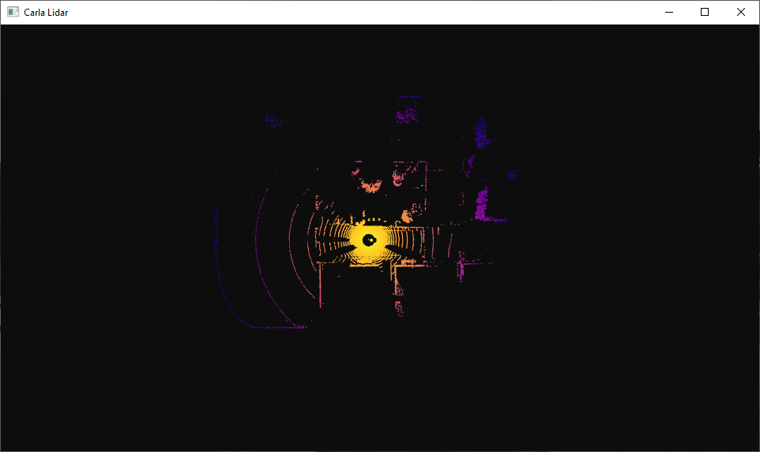
Sensors for Contest
CARLA LIDAR Coding Example
1. Define sensor callback function
def lidar_callback(point_cloud, point_list): """Prepares a point cloud with intensity colors ready to be consumed by Open3D""" data = np.copy(np.frombuffer(point_cloud.raw_data, dtype=np.dtype('f4'))) data = np.reshape(data, (int(data.shape[0] / 4), 4)) # Isolate the intensity and compute a color for it intensity = data[:, -1] intensity_col = 1.0 - np.log(intensity) / np.log(np.exp(-0.004 * 100)) int_color = np.c_[ np.interp(intensity_col, VID_RANGE, VIRIDIS[:, 0]), np.interp(intensity_col, VID_RANGE, VIRIDIS[:, 1]), np.interp(intensity_col, VID_RANGE, VIRIDIS[:, 2])] points = data[:, :-1] points[:, :1] = -points[:, :1] point_list.points = o3d.utility.Vector3dVector(points) point_list.colors = o3d.utility.Vector3dVector(int_color)
2. Config sensor parameters
# Set up LIDAR, parameters are to assisst visualisation lidar_bp = bp_lib.find('sensor.lidar.ray_cast') lidar_bp.set_attribute('range', '100.0') lidar_bp.set_attribute('noise_stddev', '0.1') lidar_bp.set_attribute('upper_fov', '15.0') lidar_bp.set_attribute('lower_fov', '-25.0') lidar_bp.set_attribute('channels', '64.0') lidar_bp.set_attribute('rotation_frequency', '20.0') lidar_bp.set_attribute('points_per_second', '500000') lidar_init_trans = carla.Transform(carla.Location(z=2)) lidar = world.spawn_actor(lidar_bp, lidar_init_trans, attach_to=vehicle)

Slide 29
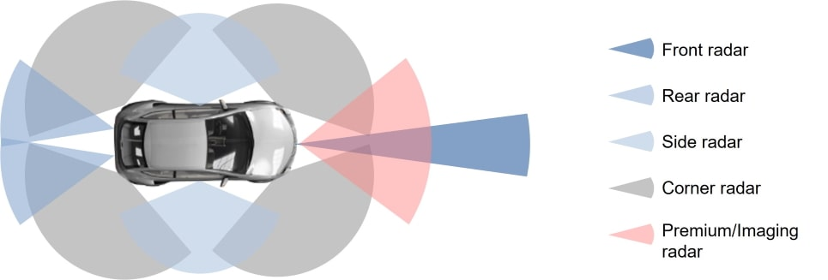
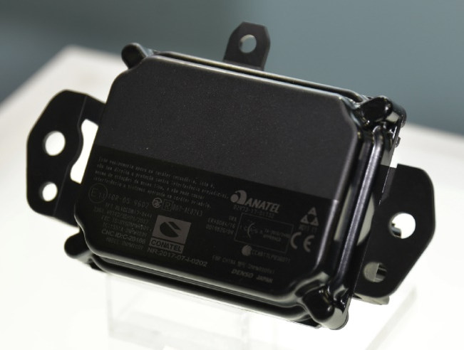
Sensors for Contest
Radar (Radio Detection and Ranging) is a radiolocation system that uses radio waves to determine the distance (ranging), angle (azimuth), and radial velocity of objects relative to the site.
Attribute | Description
horizontal_fov | Horizontal field of view in degrees.
points_per_second | Points generated by all lasers per second.
range | Maximum distance to measure/raycast in meters.
sensor_tick | Simulation seconds between sensor captures (ticks).
vertical_fov | Vertical field of view in degrees.
Phased-Array Radar

Slide 30
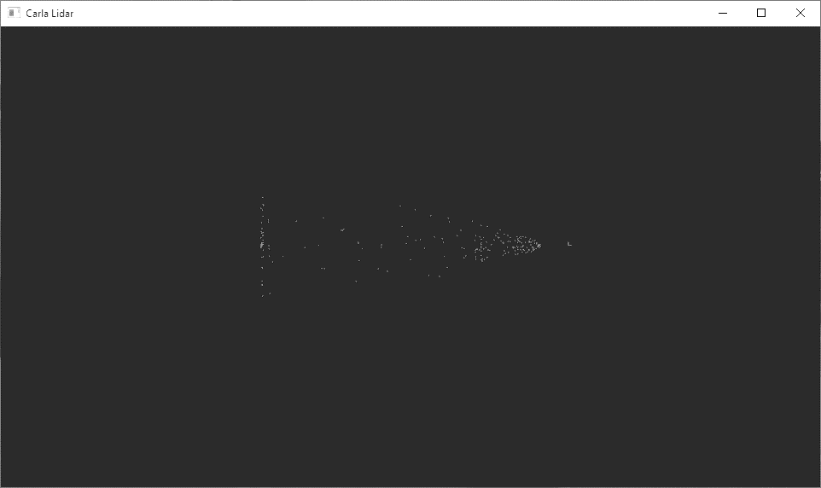
Sensors for Contest
CARLA RADAR Coding Example
1. Define sensor callback function
def radar_callback(data, point_list): radar_data = np.zeros((len(data), 4)) for i, detection in enumerate(data): x = detection.depth * math.cos(detection.altitude) * math.cos(detection.azimuth) y = detection.depth * math.cos(detection.altitude) * math.sin(detection.azimuth) z = detection.depth * math.sin(detection.altitude) radar_data[i, :] = [x, y, z, detection.velocity] intensity = np.abs(radar_data[:, -1]) intensity_col = 1.0 - np.log(intensity) / np.log(np.exp(-0.004 * 100)) int_color = np.c_[ np.interp(intensity_col, COOL_RANGE, COOL[:, 0]), np.interp(intensity_col, COOL_RANGE, COOL[:, 1]), np.interp(intensity_col, COOL_RANGE, COOL[:, 2])] points = radar_data[:, :-1] points[:, :1] = -points[:, :1] point_list.points = o3d.utility.Vector3dVector(points) point_list.colors = o3d.utility.Vector3dVector(int_color)
2. Config sensor parameters
# Set up RADAR, parameters are to assisst visualisation radar_bp = bp_lib.find('sensor.other.radar') radar_bp.set_attribute('horizontal_fov', '30.0') radar_bp.set_attribute('vertical_fov', '30.0') radar_bp.set_attribute('points_per_second', '10000') radar_init_trans = carla.Transform(carla.Location(z=2)) radar = world.spawn_actor(radar_bp, radar_init_trans, attach_to=vehicle)

Slide 31
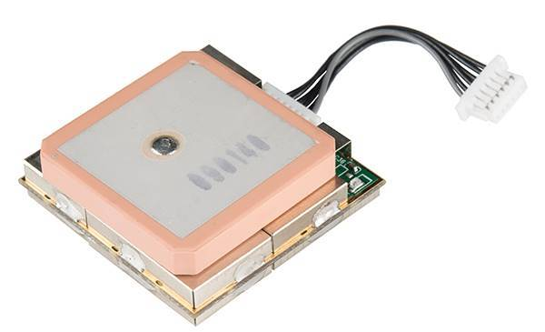
Sensors for Contest
Global Navigation Satellite System (GNSS)
Commonly known as GPS (Global Positioning System)

Slide 32

Sensors for Contest
CARLA Navigation Coding Example
1. Initial sensor
# Add navigation sensor gnss_bp = bp_lib.find('sensor.other.gnss') gnss_sensor = world.spawn_actor(gnss_bp, carla.Transform(), attach_to=vehicle)
2. Define sensor callback function and data buffer
def gnss_callback(data, data_dict): data_dict['gnss'] = [data.latitude, data.longitude]
# Initialise data
sensor_data = {'gnss': [0, 0],}
3. Start recording sensor data
# Start sensors recording data gnss_sensor.listen(lambda event: gnss_callback(event, sensor_data))

Slide 33
Sensors for Contest
Inertial Measurement Unit (IMU) is a device that typically consists of gyroscopes to measure and report angular rate and accelerometers to measure and report specific force.

Slide 34
Sensors for Contest
CARLA IMU Coding Example
1. Initial sensor
# Add inertial measurement sensor imu_bp = bp_lib.find('sensor.other.imu') imu_sensor = world.spawn_actor(imu_bp, carla.Transform(), attach_to=vehicle)
2. Define sensor callback function and data buffer
def imu_callback(data, data_dict): data_dict['imu'] = { 'gyro': data.gyroscope, 'accel': data.accelerometer, 'compass': data.compass }
# Initialise data
sensor_data = { 'imu': { 'gyro': carla.Vector3D(), 'accel': carla.Vector3D(), 'compass': 0 }}
3. Start recording sensor data
# Start sensors recording data imu_sensor.listen(lambda event: imu_callback(event, sensor_data))

Slide 35
Demo

Slide 36
Q&A

Slide 37
Appendix

Slide 38





Resource
Online Introduction Document
Supplement Information
CARLA Installer
CARLA Installer (Map)
Video Demo

